Slide 1
Why Christians sing
Praise and worship
Recognising (vv1-2, 11)
Remembering (vv4-10)
Reputation (vv14-15)

Slide 3
Worship

Slide 4
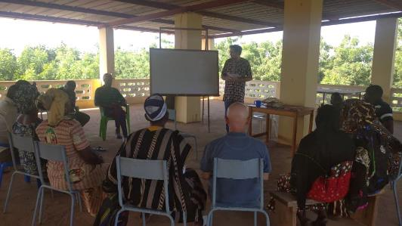
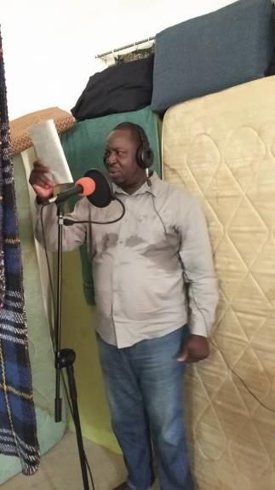
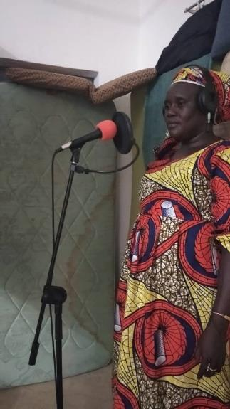
Worship

Slide 5
Maxa jikkirankuti,
an do an kaman wa doome.
Muumunte…
Muruxunte…
Finkinte…
Watunte…
Do not despair,
You and your Lord are together.
Those who can’t speak…
Those who can’t walk…
Those who can’t see…
Those who are injured…

Slide 6
Maxa jikkirankuti,
an do an kaman wa doome.
Muumunte…
Muruxunte…
Finkinte…
Watunte…
Do not despair,
You and your Lord are together.
Those who can’t speak…
Those who can’t walk…
Those who can’t see…
Those who are injured…

Slide 7
Allelu, alleluia, glory to the Lord
Allelu, alleluia, glory to the Lord
Allelu, alleluia, glory to the Lord
Alleluia, glory to the Lord

