Slide 1
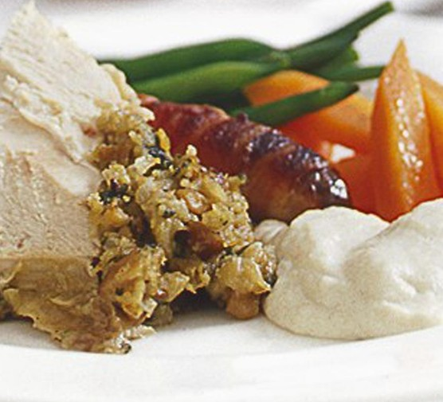
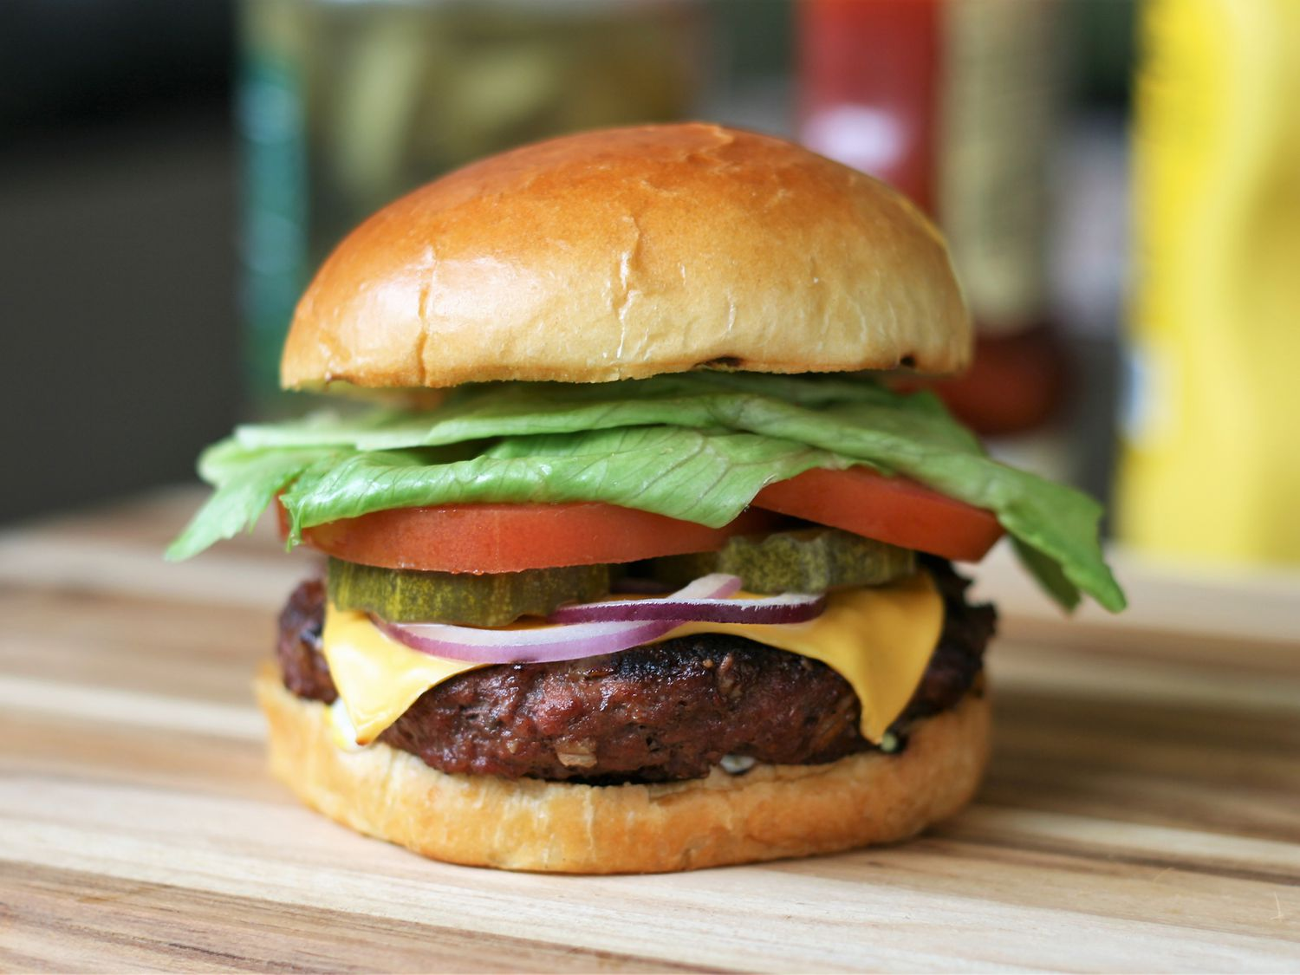
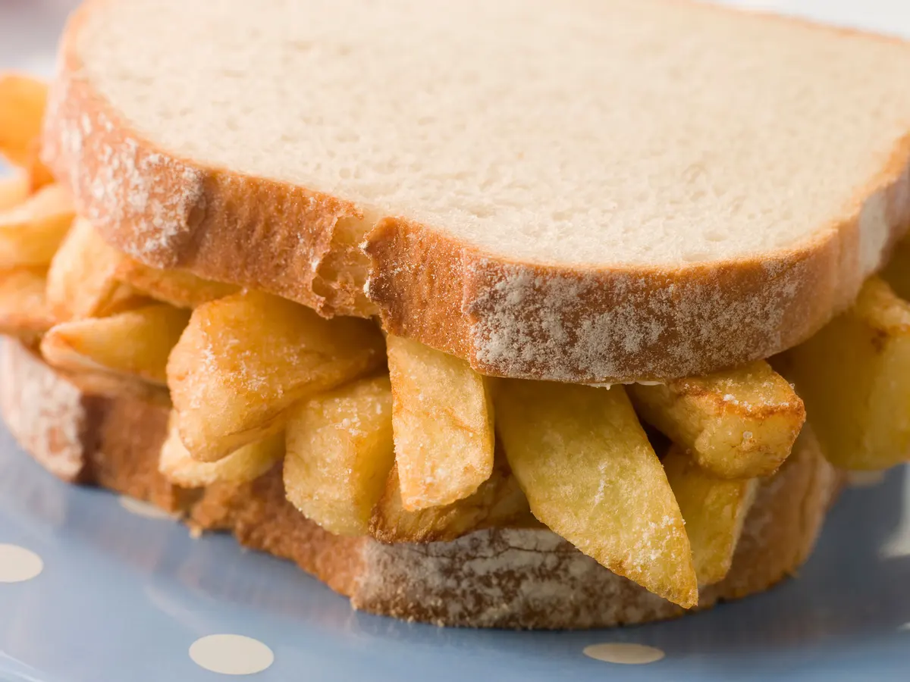
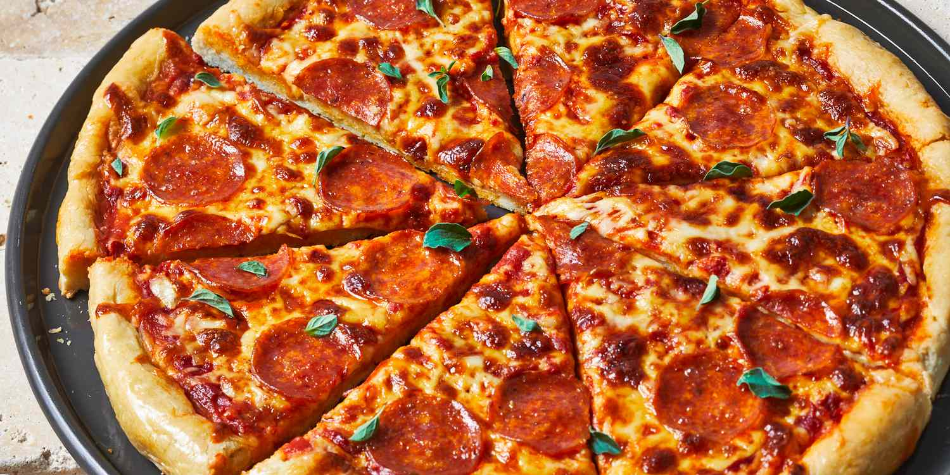

Slide 2
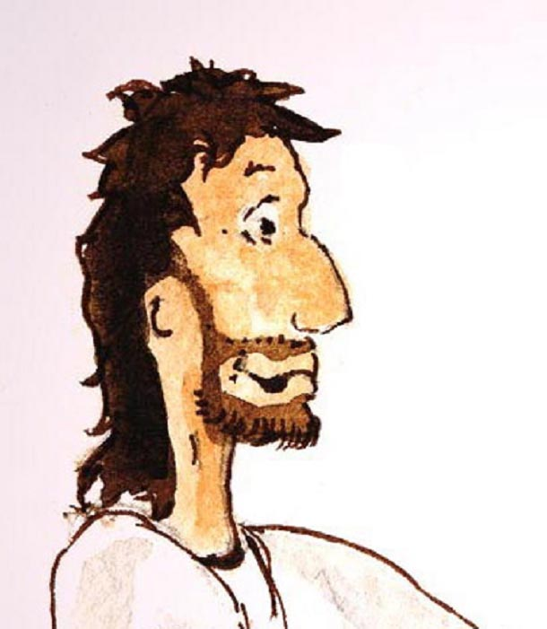
I am the
bread
of life…

Slide 3
I am the bread of life…

Slide 4
I am the bread of life…

Slide 5
I am the bread of life…

Slide 6
I am the
bread of life…
Whoever comes to me will never go hungry and whoever comes to me will never go thirsty.

